Slide 1
Digital Client Onboarding Stream
Personal & Motive DCO Project
Project Kick off
Date: April 28, 2020

Slide 2
Project Background
Benefits
Project Scope Overview
Measures of Success
Constraints/Dependencies
Assumptions/Risks
High Level Timeline
Project Team
Issue Management and Escalation
Project Management Methodology
Thank You
Kick Off

Slide 3
Welcome to the Digital Program
Personal & Motive Digital Client Onboarding Project
Under the Digital Client Onboarding Stream

Slide 4
Project Background
The Personal & Motive Digital Client Onboarding Project is part of the overall Digital Program and the Digital Client Onboarding (DCO) Program stream. The DCO Program stream includes the following Projects:
Motive DCO Minimal Viable Product (MVP)
Motive Full/Personal/In Branch DCO
Small Business DCO
Small Business Lending
The purpose of this Program stream is to enhance and implement the Temenos digital client onboarding platform called Infinity.
Problem Statement: The current digital client onboarding service is manual and needs to be conducted in/by a branch. There is no current functionality for a client to open an account online independently except for Motive.

Slide 5
High Level Benefits
The following high level benefits have been identified:
  Reduce manual efforts that are currently required to open new accounts, and improve compliance and data integrity.
  Digital Client Onboarding will offer personal and small business clients a much faster way to open deposit and lending products remotely, which will benefits prospective new clients who are outside of CWB’s current geographic branch footprint.
  Reducing manual efforts required by CWB staff will improve the employee experience and allow them to focus on more value-add activities.

Slide 6
Project Scope Overview
The scope of the Digital Client Onboarding program stream includes the Motive MVP, Motive Full/Personal/In Branch DCO, Small Business DCO and Small Business Lending projects. Each project will entail:
Requirements Definition/Current State Assessment/Gap Analysis
Solution design
Development
Testing
Training
Deployment

Slide 7
Measures of Success
Scope
The scope of the project aligns to the Project Charter and managed within the PMO framework.
Time
Delivery of the project within the planned schedule.
Budget
The project is completed within budget.
Quality
The digital client onboarding service is implemented per the agreed to requirements.
Benefits
Achieve the benefits identified in the Program Charter.

Slide 8
Constraints/
Dependencies
Constraints
The project will be using the Agile methodology with two week sprints, therefore work will be broken into multiple, two-week intervals.
Dependencies
Digital Online Banking Project for Small Business and Personal;
CWB Mulesoft and Infrastructure Implementation Project;
AML Financial Crimes Project;
T24 Virtualization;
Sitecore Upgrade; and
Identity and Access Management.

Slide 9
Risks/Assumptions
RISKS | MITIGATION STRATEGY
Solution does not meet business needs | Define business requirements and assess against products.
Resistance to change by stakeholders. | Engage the Organizational Change Management team to address change and training requirements.
Inadequate testing due to complexities and dependencies of systems | Establish a formal test plan with dedicated test lead to facilitate each of the testing cycles.
Application may not function as expected | Testing will be performed on applications to ensure they function as expected. Any issues identified will be addressed prior to deployment.
Resource Constraints with same team members on DCO and Digital Banking. | Will work with the schedule to align resources as best as possible to minimize project impacts.

Slide 10
Digital Program – Roadmap Summary
2019
2020
2021
Nov
Jan
Mar
May
Jul
Sep
Nov
Jan
Jan 29
Mar
May
2019
Program Setup + Governance Established
Motive DCO - Friends & Family Launch
Note: Dates may shift over 2020/21 as the team iterates
2021
Nov 18, 2019
Today
Feb 28, 2020
June 22, 2020
75 days
Motive DCO Project – Initial Implementation
Motive DCO - Full Launch
July 13, 2020
Dec 9, 2019
Personal DCO - Friends & Family Launch
Aug 17, 2020
116 days
Personal Online DCO Project & Motive DCO Project – Full Implementation
Personal Online DCO – Full Launch
Dec 9, 2019
Sep 14, 2020
Personal In Branch DCO Project - Full Implementation
201 days
May 2020
Oct 2020 - TBC
Small Business DCO Project (Go Live Ready)
130 days
Program Stream 1
Jun 1, 2020
Nov 2020
Digital Client Onboarding (DCO)
Small Business Lending Project (Go Live Ready)
Sep 23, 2020
Mar 2021
129 days
Small Business + Personal Banking Pre-Planning
54 days
Small Business Banking Launch
(Initial Focused Launch)
Jan 6, 2020
Mar 19, 2020
Small Business Banking Implementation
225 days
Mar 20, 2020
Jan 2021
Personal Banking Implementation (Go Live Ready)
246 days
Mar 20, 2020
Feb 2021
Program Stream 2
Corporate Banking Implementation (Go Live Ready)
192 days
Digital Banking (DB)
Oct 5, 2020
Jun 2021

Slide 11
High Level Estimated Timeline – Motive MVP

Slide 12
High Level Estimated Timeline – Motive Full/Personal/In Branch DCO

Slide 13
High Level Estimated Timeline – Small Business DCO

Slide 14
High Level Timeline – Small Business Lending

Slide 15
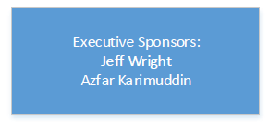
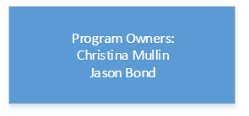
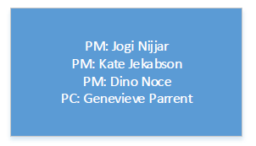
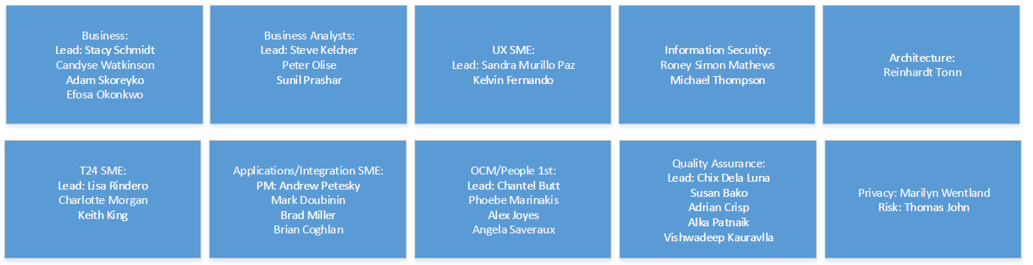
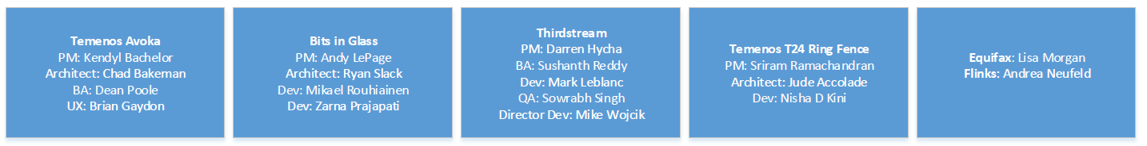
Project Organization

Slide 16
Issue Management and Escalation Process

Slide 17
Project Management Project Delivery Lifecycle
Monitoring and Controlling ensuring controls are in place to manage the project work
Performing Integrated Change Control
Initiation Phase
Project Kick off
Project Charter
New Initiative/Change Risk Assessment Tool
Project Management Plan
Develop project schedule and plans
SDLC: Requirements Gathering
Planning Phase
Monitoring and Controlling Phase
Direct and manage the work
Manage Communications
Perform quality assurance
Conduct procurement
SDLC: Design, Build, Test, Go Live
Execution Phase
Close of project or phase
Lessons Learned Report
Closure Report
Closure Phase

Slide 18
Thank You

